Slide 1
More HTML Elements
Introduction to Web development

Slide 2
Agenda
HTML Lists
HTML Attributes
HTML Links
Multiple HTML Pages

Slide 3

Lists in HTML

Slide 4
The list elements: ul and ol
Lists are used to display groups of items
They can be unordered or ordered
Each item is its own HTML element: li
<ul>
<li>Eggs</li>
<li>Milk</li>
</ul>
<ol>
<li>Iron Man</li>
<li>The Hulk</li>
</ol>
Notes:
The bullet points on this slide are an unordered list!
An ordered list has numbers – for example, the MCU movies in release order

Slide 5
Parent/child relationships in HTML
<ul>
<li>Item A</li>
<li>Item B</li>
<li>Item C</li>
</ul>
<ul>
</ul>
Parent element
<li>
</li>
Child element
Notes:
Note that child elements go within parent elements. Start with the opening tag for the UL , then put the full LI elements (opening tag, content, closing tag), then the closing tag for the UL

Slide 6
List Example
https://replit.com/@HylandOutreach/ListExample
Notes:
Visit the Repl to show lists in action.
Here we really want to emphasize the hierarchical structure of HTML
Also show switching from <ul> to <ol>
Ask about the relationship between elements

Slide 7
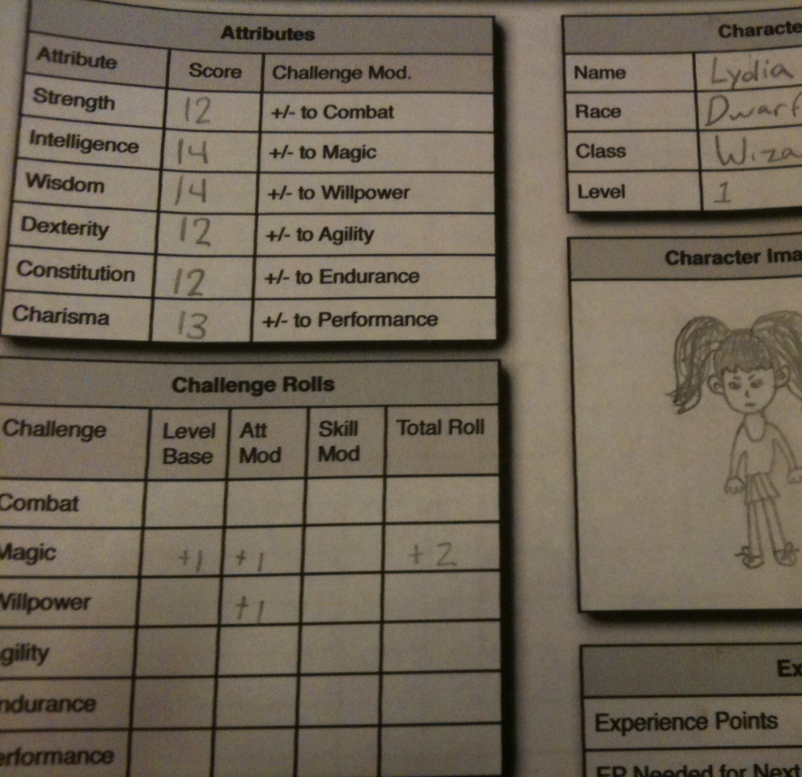
HTML Attributes

Slide 8
Attribute example: The image element
<img src="http://google.com/dog.jpg">
Q: What does the src do?
A: The src attribute tells the website which image to show on the page
Notes:
Ask the students what href does – it tells the link where to go when clicked!

Slide 9
What are attributes?
Attributes add extra information to HTML elements
They change what an element does
Attributes go inside of the opening tag of an HTML element
<img src="picture.jpg">
Attribute name, equals sign, quotation marks, attribute value
Notes:
Point out each part of the attribute syntax

Slide 10
Mini-quiz
<img src="dog.png">
What is the attribute name?
src
What is the attribute value?
dog.png
Notes:
Ask the students these questions

Slide 11
Attributes Examples
https://replit.com/@HylandOutreach/AttributeExamples
Notes:
Visit the Repl to show attributes in action. Uncomment the commented lines of code to display them. You should be able to use Ctrl+/ to comment and uncomment code in Repl

Slide 12

HTML Links
Notes:
Ask the students if they recognize this character. It’s Link from Zelda!

Slide 13
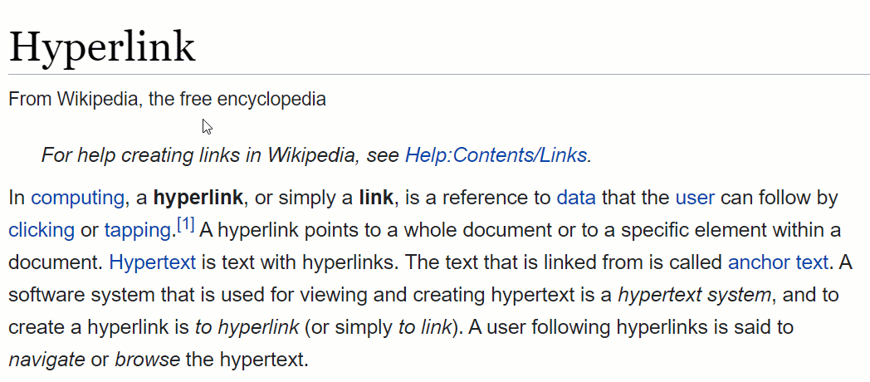
What is a link on a website?
In a website, a hyperlink (or link) is an item like a word or button that points to another location
What is a URL?
A URL is an address that is used to locate resources on the web

Slide 14
How to make a link in html – a element
<a href="http://google.com">Click Me</a>
Where will this link go?
http://google.com
What will the link say?
Click Me
What is the attribute?
href
What is the tag name?
a
Notes:
Show the example of a link – the a or anchor element
Have the students guess the answers to these questions – and then reveal the answers

Slide 15
Link Examples
https://replit.com/@HylandOutreach/LinkExamples
Notes:
Show some examples of links. There are also a couple of broken ones – have the students try to figure out what is wrong with those.

Slide 16

MULTIPLE pages

Slide 17
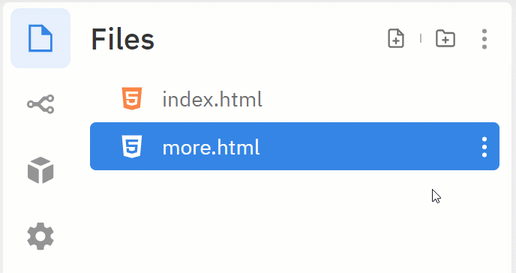
Adding a new file in replit
Click the “Add file” button
Enter the filename
Make sure it ends in .html
Press Enter
Note: the index.html file will always be the homepage
Notes:
The first step to having multiple HTML pages is to make multiple files.

Slide 18
Linking to the new file with an a element
<a href="newpage.html">Go to New Page</a>
What will happen when this link is clicked?
The website will open the newpage.html file
What is the href value?
newpage.html
Notes:
Show what a link to a new file looks like – it’s another a element.
Ask the students to guess the answers to some questions, and then reveal the answers.

Slide 19
Multiple Pages Examples
https://replit.com/@HylandOutreach/MultiplePagesExample
Notes:
Show an example of a website that contains multiple pages.

Slide 20
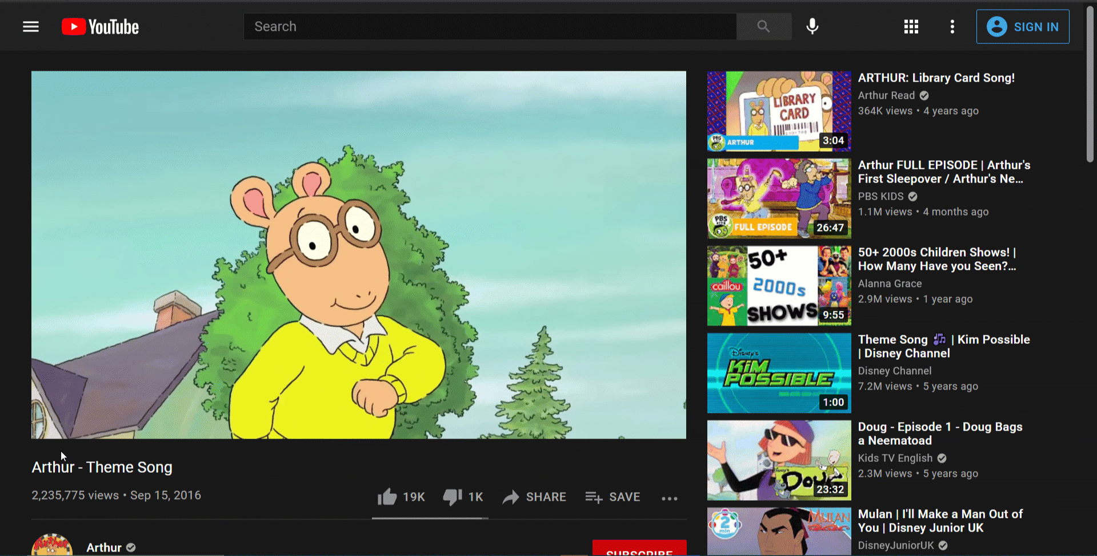
BONUS: Embedding youtube videos
Copy an iframe element from YouTube, and paste it into your HTML!
SHARE – Embed - COPY
Notes:
As a bonus, show students how it is possible to embed most youtube videos on their websites.

Slide 21
Embedded Youtube Video Example
https://replit.com/@HylandOutreach/YouTubeEmbed
Notes:
Show an example of a website that contains an embedded YouTube video.

Slide 22
Questions?

